Slide 1
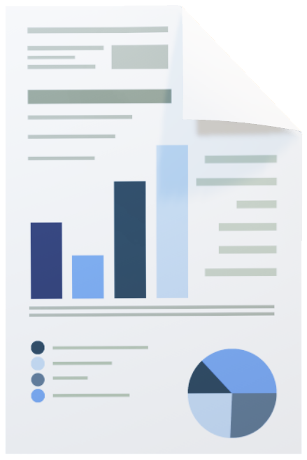

Task 3 analytics and commercial application

Slide 2
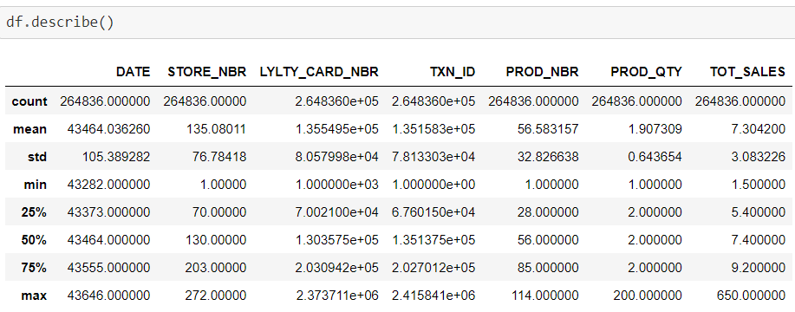
task 1-
There are basically we have to find the three points inside the task 1 lets see this below.
Creating and interpreting high level summaries of the data
Finding outliers and removing these (if applicable)
Checking data formats and correcting (if applicable)
Lets see the solutions one by one .
Creating and interpreting high level summaries of data (dataset)

Slide 3
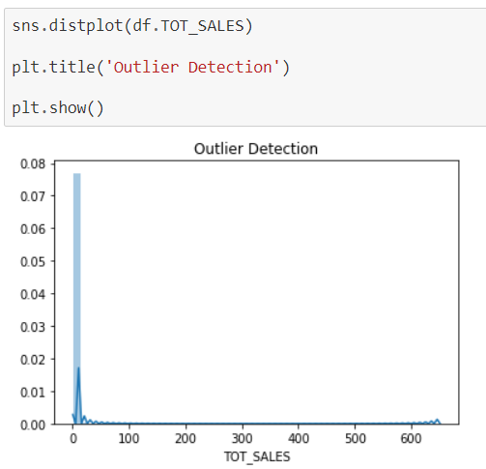
Detecting the outliers-

Slide 4
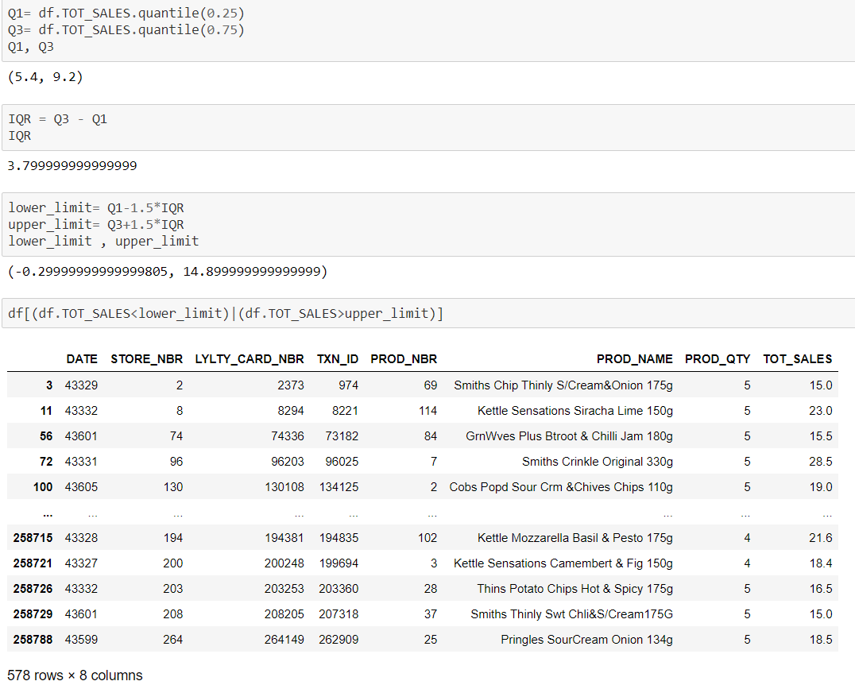
Finding outliers and removing these (if applicable)

Slide 5
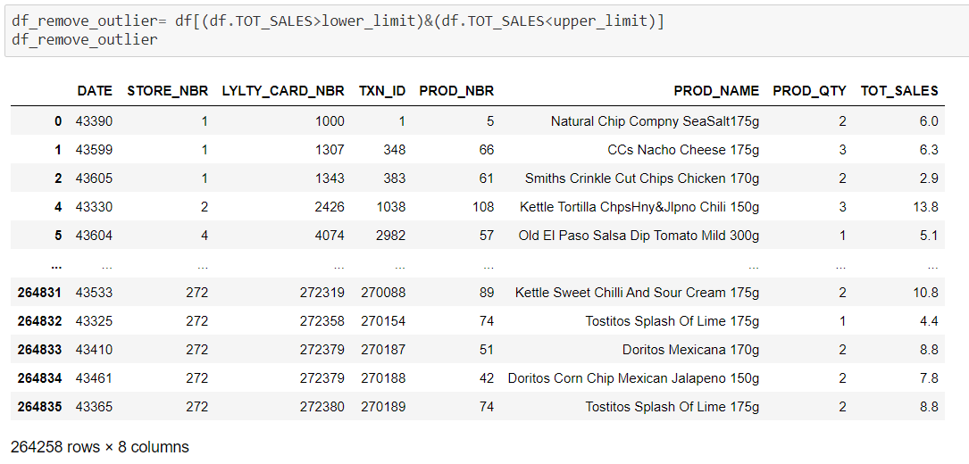
Removing outliers

Slide 6
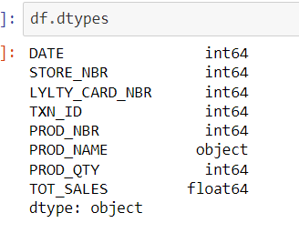
Checking data formats and correcting (if applicable)
Python coding file for task 1: available here

Slide 7

Task 2

Slide 8
Total sales revenue
Total number of customers
Average number of transactions per customer
provided dataset-
Total sales revenue
Average number of transactions per customer
Total number of customers

Slide 9
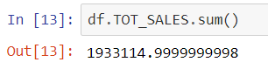
Total sales revenue-

Slide 10

Total number of customers –

Slide 11
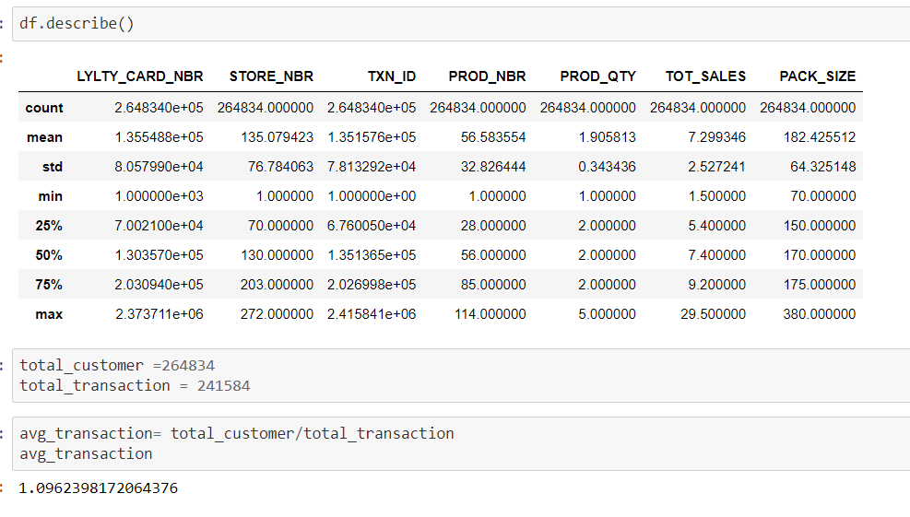
Average number of transactions per customer
Python coding file for task 2 : available here

Slide 12

That’s it
thank
you
for watching .

